Slide 1
Managing Challenging Patients Kristy Engel, PsyD
1 |

Slide 2
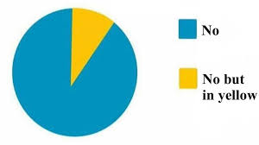
Financial Disclosures and Conflicts of Interest

Slide 3
Objectives
Appreciate what can contribute to challenging interactions
Identify provider, system, and patient factors
Discern what might be contributing to the patient’s presentation
Identify ways to respond appropriately

Slide 4
Not challenging patients but challenging situations
In any type of service profession, you will likely come across “difficult” encounters with people
What might cause someone to be difficult in one situation might be different than in others
As many as 15 percent of patient-physician encounters are rated as “difficult” by the physicians involved
Providers’ own attitudes and behaviors may also contribute to difficult encounters with patients
Jackson JL, Kroenke K. 1999

Slide 5
Influences on the interaction
Provider factors
Caseload
Burnout
Level of experience/comfort
Stimulus value
Feeling angry or defensive
Being distracted or time pressured
Reacting in a condescending way
“Blaming the patient”
Health care system factors
Staffing
Cost/time pressure
Space/environment
https://www.mdlinx.com/internal-medicine/article/2981; Haas, et al., 2005

Slide 6
Types of Difficult Patients
Demanders
Characteristics:
Never satisfied with their care
Try to dictate their care
Need “faster” response times to their concerns
May be verbally abusive to staff
May be a temporary reaction to severe pain or symptoms
https://www.mdlinx.com/internal-medicine/article/2981

Slide 7
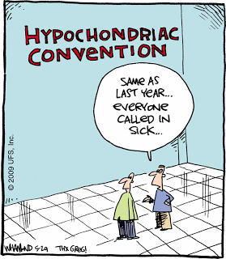
Types of Difficult Patients
“Hypochondriacs” (AKA “Frequent Flyers”)
Characteristics:
call all the time with new medical problems
fixate on the miniscule symptoms
not convinced when things are normalized
tend to be comfortable in the sick role
they often have “doctor-shopped” and likely have a history of multiple diagnostic tests and medication allergies
https://www.mdlinx.com/internal-medicine/article/2981

Slide 8
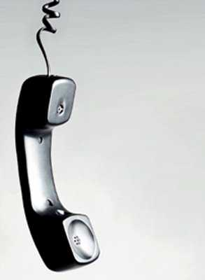
Types of Difficult Patients
Avoiders
Characteristics
don’t return phone calls from the transplant team
don’t call the transplant team when something meets criteria warranting a call
only call when there’s a problem they perceived needs to be fixed
https://www.mdlinx.com/internal-medicine/article/2981

Slide 9
Types of Difficult Patients
Manipulators
Characteristics
play on the guilt of others, threatening physical harm, legal action or suicide
get fixated on what they want in the moment and can be impulsive
do not disclose important details during the evaluation that then impact the working relationship afterwards
https://www.mdlinx.com/internal-medicine/article/2981

Slide 10
In the situation…
Steps for responding:
Self-examination
Understanding/appreciation for what might be contributing to the patient’s presentation

Slide 11
Patient Factors
Table 1: Common Psychosocial Issues Identified in Transplant Patients and Families
Experiencing emotional highs and lows that are potential adverse effects of immunosuppressive agents, such as corticosteroids Stress and challenges due to complex posttransplant regimens including multiple medications and complicated dosing schedules, regular follow-up medical evaluations and laboratory tests, and lifestyle restrictions related to smoking, alcohol, and other potentially harmful substances Coping with physical changes and early complications, such as acute graft rejection Psychological acceptance of the transplant; for cadaver-donation recipients, this includes dealing with the circumstances that someone lost his/her life just when the transplant patient regained his/her own life Dealing with financial and economic issues, such as cost of transplant surgery, hospital stay, and/or follow-up care and medications
Dew, et al., 2014

Slide 12
Patient Factors Cont.
Anxiety
Demanders- “if I don’t get what I perceive I need, something terrible is going to happen and I can’t tolerate the limbo of not knowing”
“Hypochondriacs”- “there’s something wrong with me and no one is listening to me which makes my anxiety worse” or “if I was really “fixed,” I wouldn’t still be having different symptoms so we need to address these symptoms”
Avoiders- “uh oh- something must be wrong if the transplant center is calling and I don’t wanna deal with bad news or having to go to the hospital” or “I know this doesn’t feel right but if I call the transplant team, they’ll just tell me to take more medication or go to the hospital….”

Slide 13
Patient Factors Cont.
Depression
Avoiders- “I know something doesn’t feel right but who cares? I’m sure it’ll go away. Besides, I don’t feel like getting off the couch to do anything about this”
Personality characteristics or disorder
Demanders and Manipulators (borderline/narcissistic)- “I need what I need right now and will do or say anything to get it” or “if they don’t help me, they’ll be sorry” or “I’m paying for this time, they’re here to serve me”
“Hypochondriacs”- (dependent)- “I don’t know if I’m doing this right- I better check with my doctor”
Avoiders (avoidant)- “this is probably nothing and if I call my transplant team, they’ll just think I’m overreacting and am stupid”
Presence of a substance use disorder

Slide 14
Step 3. Responding
Acknowledge the situation (ex. “I feel like we’re getting off on the wrong foot”)
Listen carefully to patient’s concerns
Use reflective listening to let the patient know you are hearing them
Ask them to repeat back what they have heard
Set clear boundaries, limitations, and expectations; put them in writing as needed (ex. more frequent appointments in order to obtain refills; expectations regarding on call usage)
Use empathy and offer them extended help if they would like (ex. mental health referral if anxious and stressed)
https://nurse.org/articles/dealing-with-difficult-patients; https://www.jacksonvilleu.com/blog/nursing/difficult-patients/

Slide 15
Step 3. Responding cont.
Document thoroughly
Involve the family or trusted supports
Consider behavior contracting
May have to tell patients you cannot meet their needs and encourage them to find another provider (within institution or outside)

Slide 16
Conclusions
The nature of transplant work is that it can be emotionally charged
There are multiple contributing factors to challenging interactions
Being self-aware of your own contributions and stimulus value is important
Appreciating what might be contributing to the patient’s response is important
Slow down and be purposeful in your response

Slide 17
Thank you! Questions?
17 |

