Slide 1
Transplant, PTSD & COVID 19 - one patient’s story of recovering “well”
Annette Humberson,
LISW-S, CCTSW
Transplant Social Work Manager, Transplant House of Cleveland
Private MH therapist at PsychBC in Cleveland
Former Liver Transplant Social Worker, Cleveland Clinic
Oct. 16, 2020
OSOTC Symposium

Slide 2
Objectives
1). To define PTSD using the DSM V
2). To identify how PTSD could affect transplant patients, especially during the isolation of COVID
3). To advocate for patients need to heal emotionally as well as physically after a transplant, and referrals for Mental Health care if they are emotionally struggling

Slide 3
Posttraumatic Stress Disorder (PTSD) defined by: DSM-V
1). Exposure to trauma: death or threat of death or injury
2). Intrusive symptoms: memories, flashbacks, psychological distress, physical distress
3). Avoidance: trying not to think about the trauma, avoiding places that remind you of it.
4). Negative alterations: in thought and mood; amnesia, negative beliefs, distorted cognitions, lack of interest, detachment, estrangement from others, inability to experience positive emotions.
5). Arousal: Irritability, angry outbursts, reckless behavior, hypervigilance, exaggerated startle, difficulty concentrating, insomnia.

Slide 4
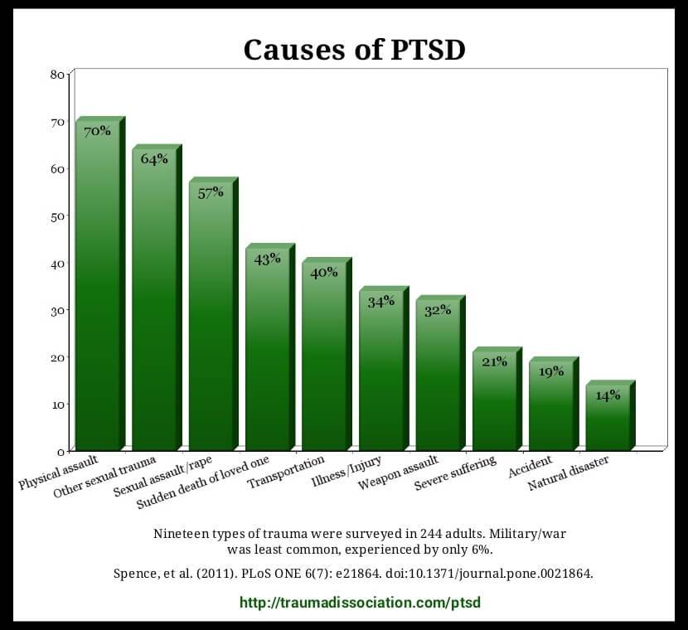
Causes of PTSD

Slide 5
How prevalent is it in transplant patients?
Nature and correlates of post-traumatic stress symptomatology in lung transplant recipients; Journal of Heart and Lung Transplantation; 2013
Background: examining the burden of post-traumatic stress disorder PTSD symptoms

Slide 6
Study examination & outcomes continued:
Methods: lung transplant patients study between April 2008 to Feb 2010
Results: 210 subjects; 12.6% of patients PTSD observed
Conclusions: PTSD in Lung Txp patients was TWO TIMES higher than the general population; future study endorsed

Slide 7
How can PTSD affect our transplant patients
Returning to the “scene” of the accident so to speak
Shattered the patient’s innocence of emotional & physical well being
What happens when they’re not “fighting for their life” anymore…
But, they’re not “cured”…

Slide 8
When a Health Crisis Leads to PTSD
Long term anxiety and distress: @ 19 yrs old, “I’m afraid to live, I’m afraid to hope – I really thought I was going to die. Who says that won’t happen again”?
1 in 5 patients in the ICU have some PTSD
1 in 8 heart attack survivors
How much worse is this during COVID?

Slide 9
Kim: new post lung transplant, during COVID
Kim – young woman in early 30’s, diagnosed 10 yrs ago with a chronic lung disease, told she might need a transplant someday
Lived her life, worked full time, completely functional, no need for oxygen, loved her family & friends, self-motivated
Did well until Dec 2019, hospitalized March 2020, evaluated urgently, listed for transplant, tx April 2020
Facetime with family daily pre-transplant, coping ok

Slide 10
The Trauma begins…
She did great for the first few days, but she clearly remembers when she was put back on the vent and there were problems – but neither her Mom or boyfriend could be here with her – she was alone andterrified!
Then she was given a medication that made her hallucinate: she saw bugs, thought they were crawling on her and didn’t know where she was, what was happening, and she became convinced she was going to die… still no one who knows or loved her could be there.
The staff tried to comfort, but they were all strangers

Slide 11
Caregivers are not visitors
Kim said, “I couldn’t remember things the care team told me, and I didn’t understand – I was so afraid – and I still am. If my Mom or boyfriend could have been there, they know me – they would have known I wasn’t acting right. They could have been my ears, and my voice, and a comfort... My Mom would have held my hand, and asked questions - But they weren’t allowed to be there to care for or speak for me. I’ll never forget how trapped, vulnerable, and overwhelmed I felt down to my core.”

Slide 12
Intended to keep us safe…But
PTSD reactions: Our body’s way of saying, “Never again will I be abused, attacked or in danger.”
Becomes a problem when: the danger isn’t there anymore but the internal alarm keeps going off anyway
Becomes a problem when: patients don’t understand why they’re feeling the way they do, start to feel guilty or ashamed
Becomes a problem when: patients try to suppress or avoid these thoughts & emotions as well as things or places that cause the “dangerous” alarm to go off

Slide 13
Today she…
Is so grateful that a Psychiatrist was consulted and saw her daily – she came to trust her
Psychiatrist prescribed medication and referred her for counseling - she is seen weekly
Grateful for her new transplant and amazing physical health improvement, but feels guilty & still afraid about the PTSD and slower mental health improvement

Slide 14
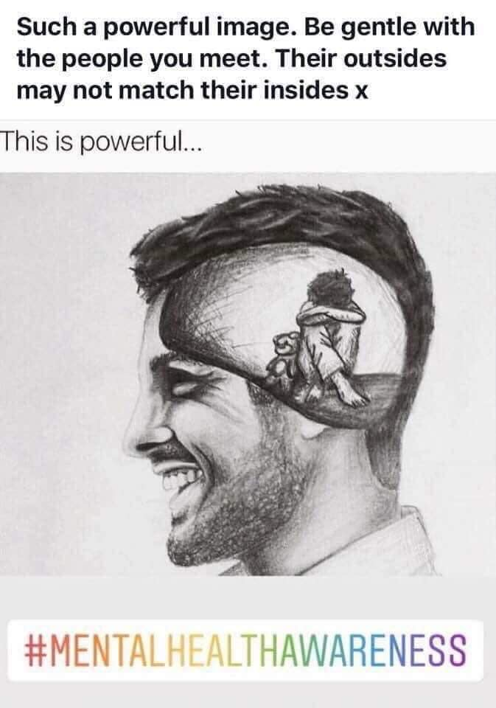
Just because a patient is physically recovering well, does not mean they are mentally recovering well. Please ask them…

Slide 15
Key Takeaways
Recognizing it as a possible problem before, during, or after a transplant
Normalizing it may help in 1-2 conversations or they may need professional help
Can be grateful and afraid at the same time; can be physically improving, and mentally declining
Psychiatry, SW, and Therapists for help

Slide 16
More thoughts & ideas
“We don’t know what will happen, but our team will be with you every step of the way”
Connecting them with another pre- or post transplant volunteer: shared experiences and living an uncertain life
Recognizing PTSD & grief reactions, please refer for MH help if needed

Slide 17
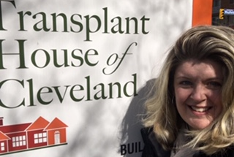
Thank you!

Slide 18
References
Surviving Transplantation; John Craven MD & Susan Farrow, OT; Toronto, 1993
Medical Crisis Counseling; Irene Pollin & Susan Baird Kanaan; 1995.
The DSM-5® Diagnostic Criteria
Growth after trauma: Why are some people more resilient than others – and can it be taught?: Leona Collier, Nov 2016; American Psychological Association.
http://www.ptsd.va.gov/PTSD/public/PTSD-overview/basics/how-common-is-ptsd.asp
Ehlers, A. & Clark, D.M. (2000). A cognitive model of posttraumatic stress disorder, Behavior Research and Therapy 38, 319-345.

Slide 19
References
Option B: Facing Adversity, Building Resilience, and Finding Joy. Sheryl Sandberg and Adam Grant, 2017.
National Center for PTSD websites, www.ptsd.va.gov/professional/assessment

