Slide 1
Impact of COVID-19 on Donor and Transplant Numbers: OPTN Update
David Klassen, M.D.
Chief Medical Officer, UNOS
October 16, 2020

Slide 2
Goals
A lot of data
A little speculation
Some questions and discussion

Slide 3
What happened?
Where are we going?

Slide 4
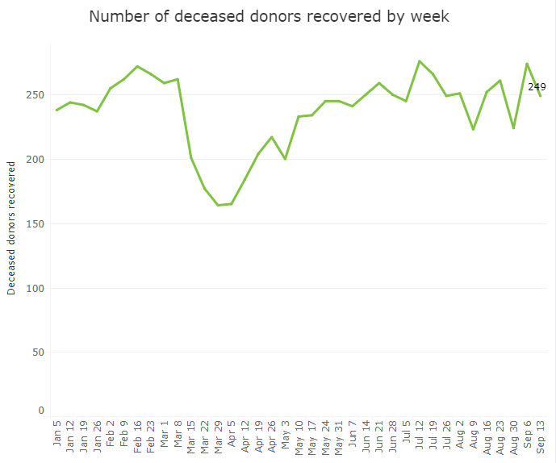
Deceased donors by week
Maureen
nationally
Notes:
Drop in March/early April, but have rebounded to typical numbers by June. Donors recovered by month were only lower than 2019’s numbers in the three months of March, April and May when things were so uncertain and testing was much less reliable than it is now.

Slide 5
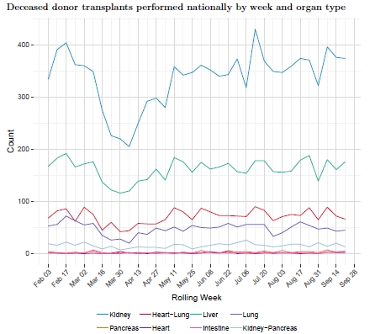
Weekly transplants by organ
Maureen
Notes:
The deceased donor transplant numbers followed the donor numbers, and you can see the same pattern of March/April drop and June/July recovery. Kidney and liver are the top two lines, and the drop is more acute in those numbers, but all organs were impacted.

Slide 6
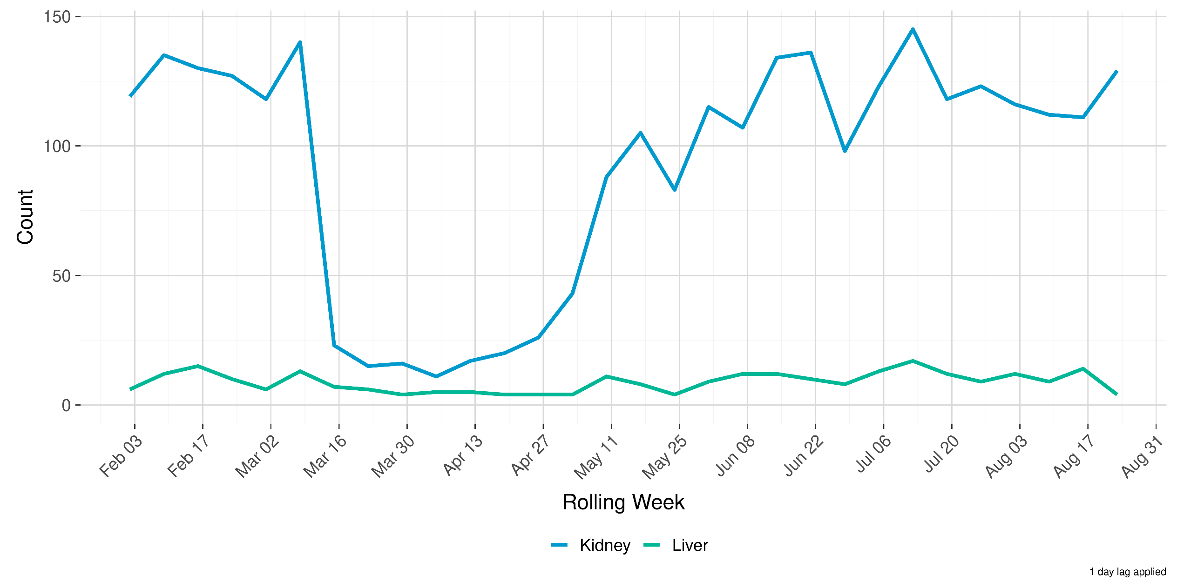
Living Donor Transplants by Week

Slide 7
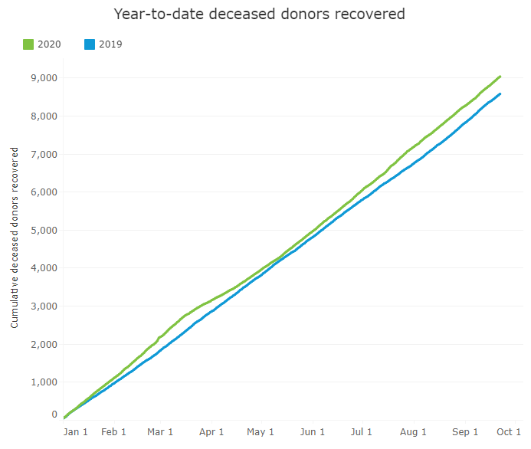
Deceased Donor Trends
Maureen
nationally
600 more donors in 2020

Slide 8
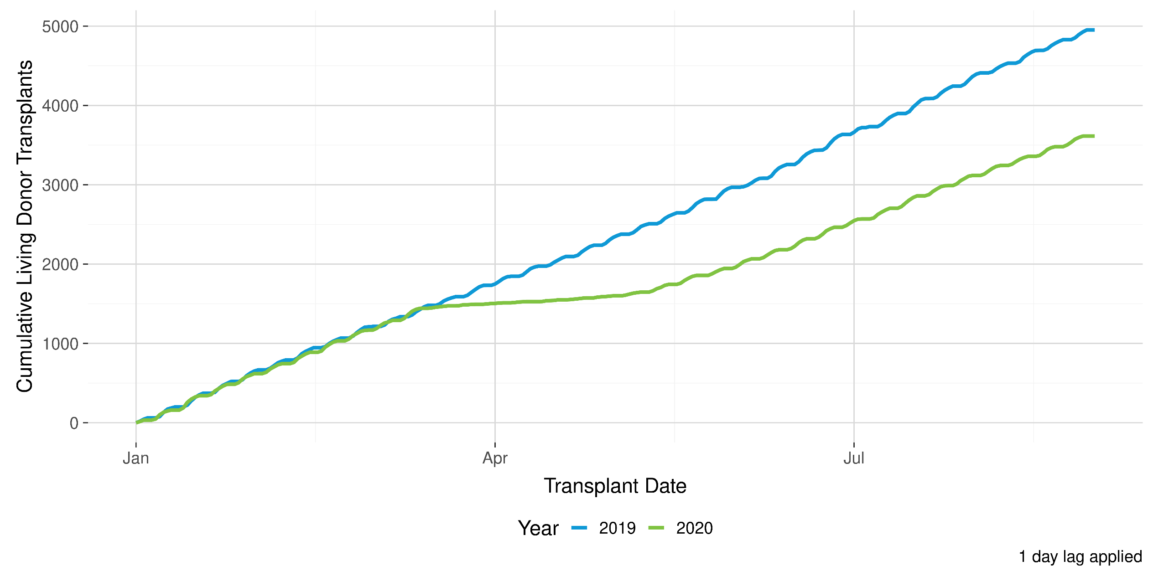
Year to Date Cumulative Living Donor Transplants

Slide 9
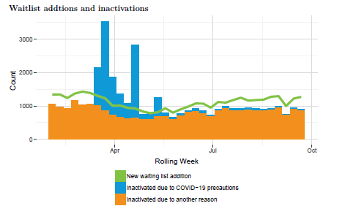
Waitlist changes
Maureen
Notes:
Orange shows the number of registrations that are inactivated, and as you can see, there is a routine amount of this activity at all times.
Blue shows the number of inactivations that were coded as Covid-related. We saw a large number of these during the early weeks of the event, but those have settled down are are very infrequent now.
The green line shows WL registrations. Registrations dropped later than donors/tranplants, and rebounded later, but are now back on our expected budget pace.

Slide 10
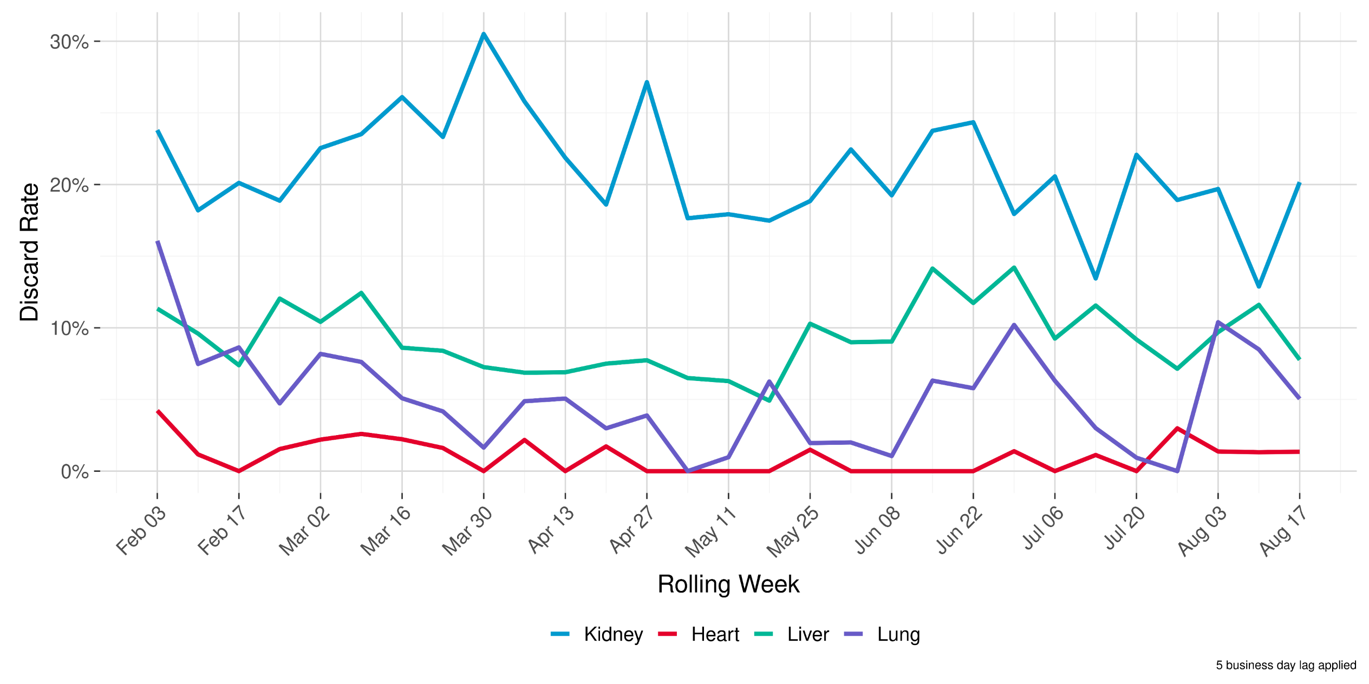
Deceased Donor Discard Rate by Week

Slide 11
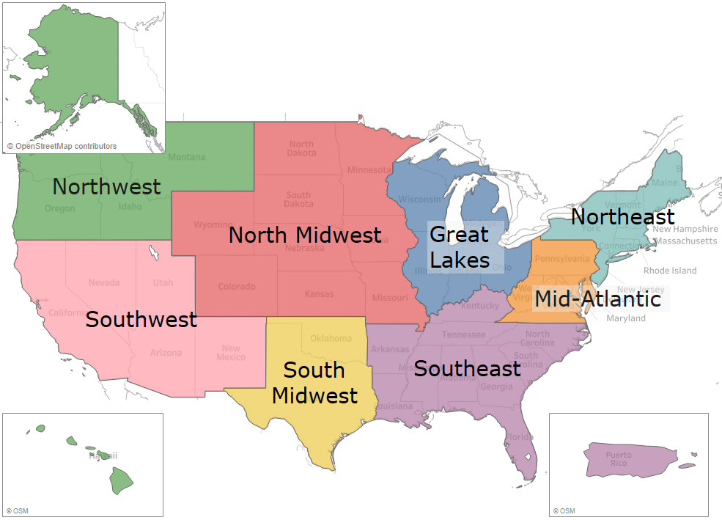
Map of Geographic Regions for this Analysis

Slide 12
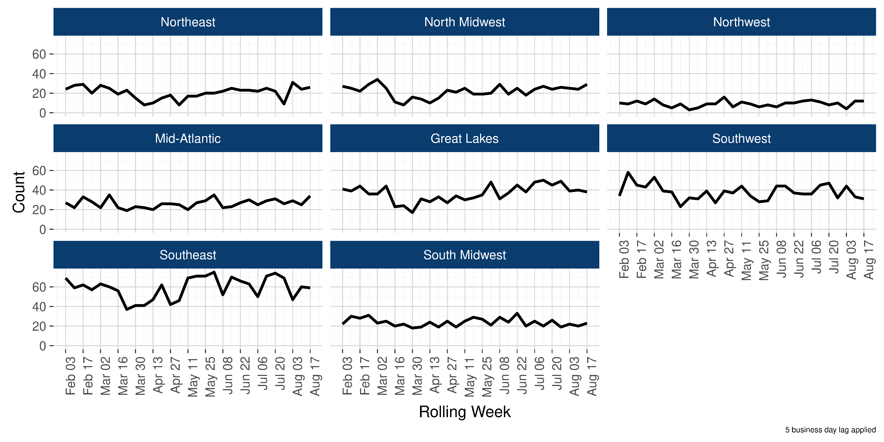
Deceased Donors Recovered by Week and Geography

Slide 13
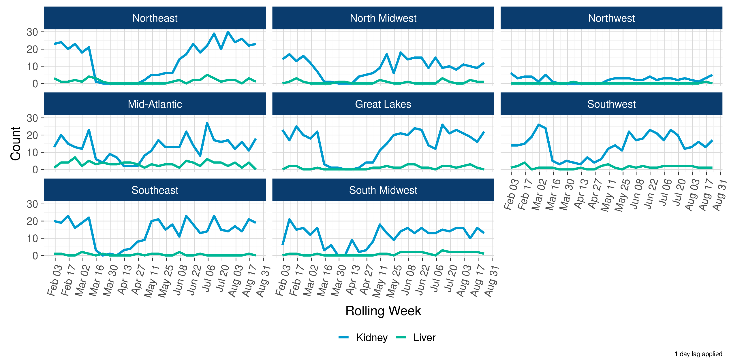
Living Donor Transplants by Week, Geography, and Organ Type

Slide 14
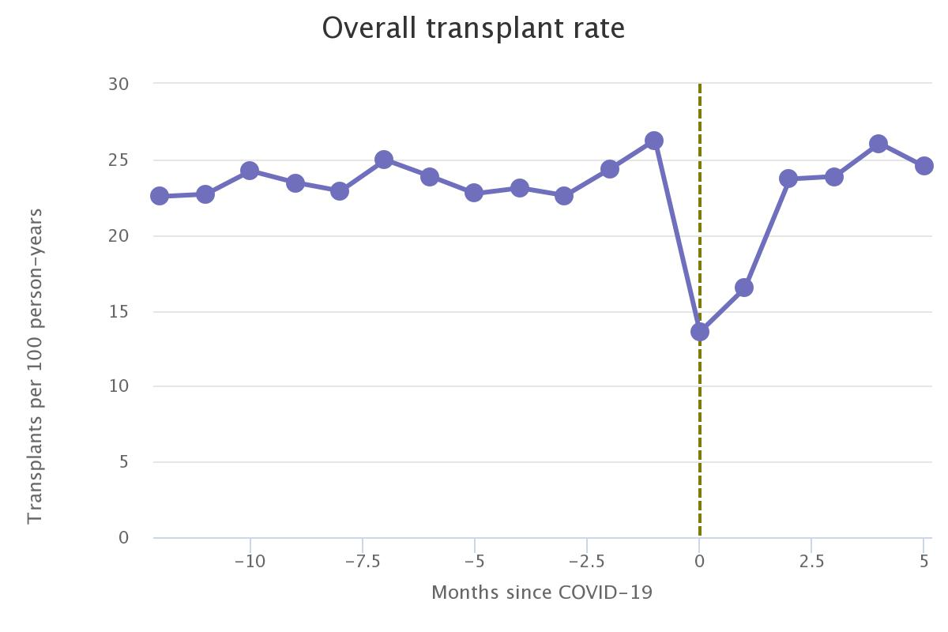
Overall Kidney Transplant Rate

Slide 15
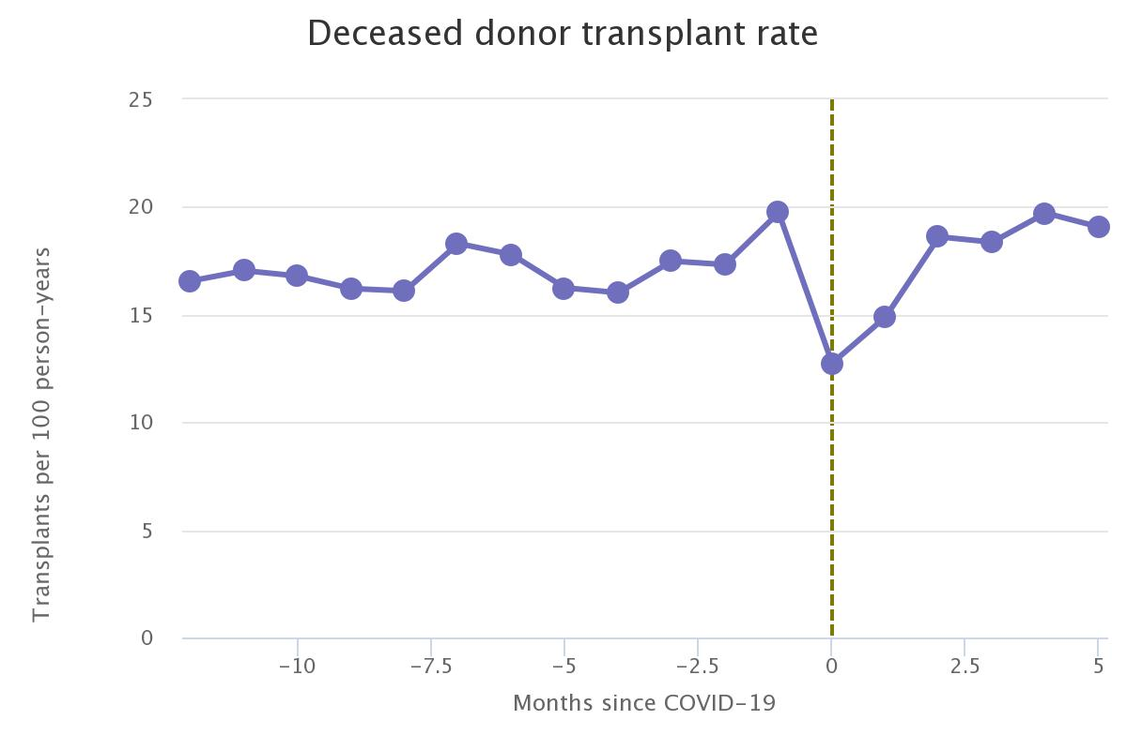
Deceased donor kidney transplant rate

Slide 16
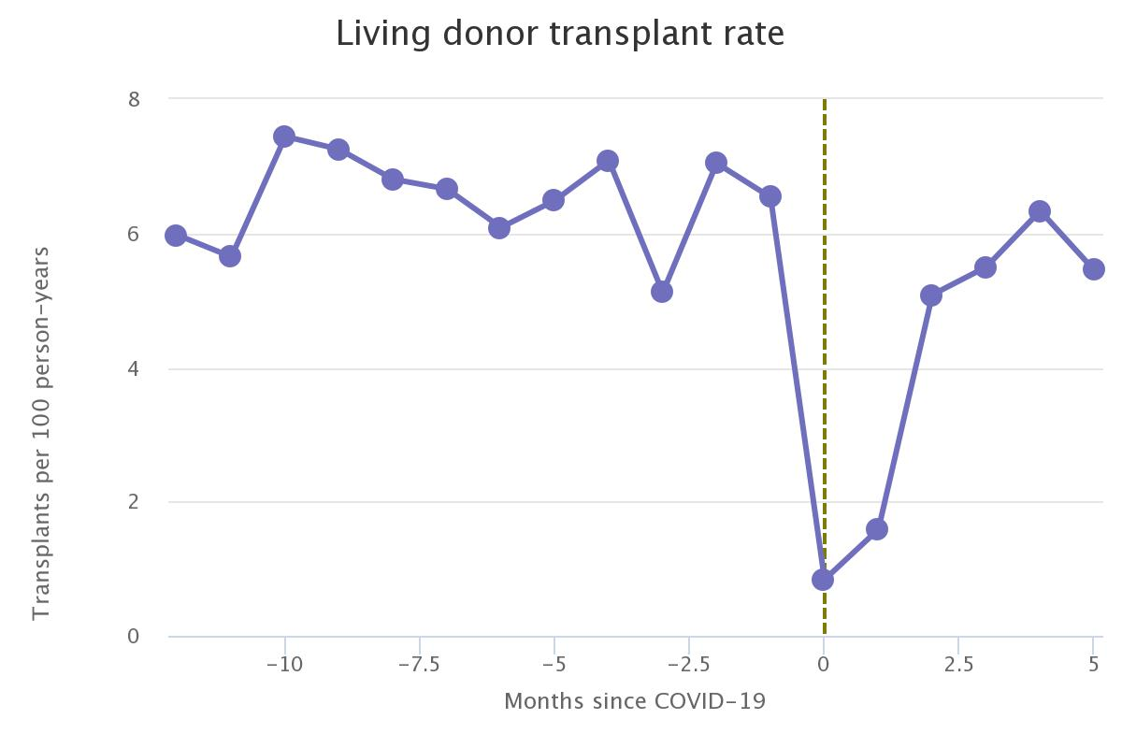
Living donor kidney transplant rate

Slide 17
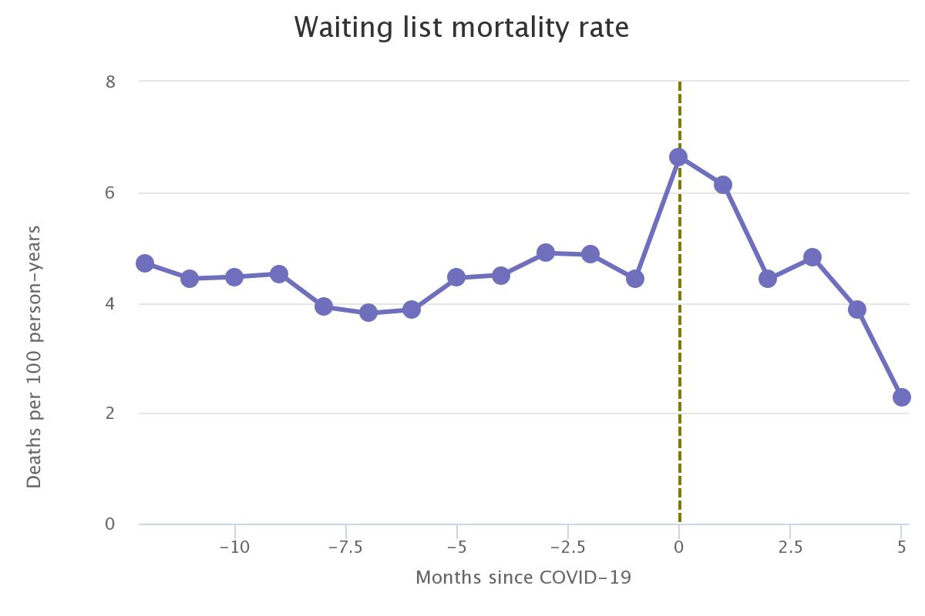
Kidney waiting list mortality

Slide 18
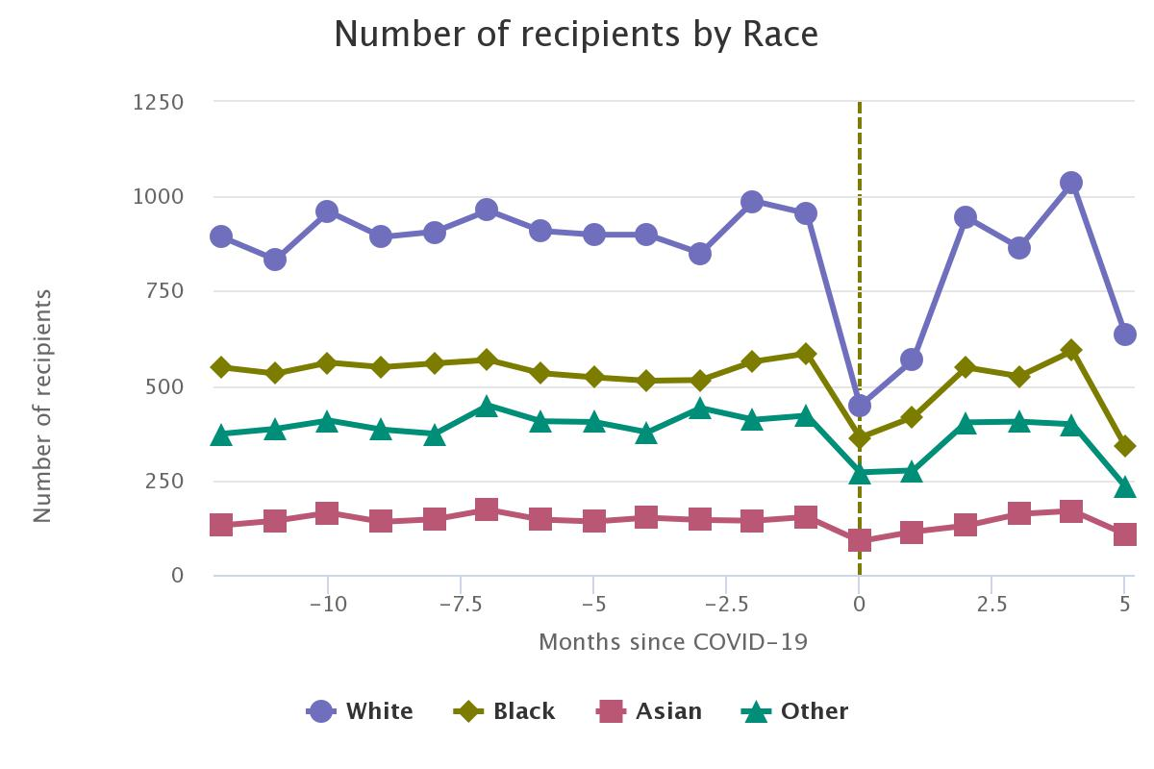
Kidney transplants by race

Slide 19
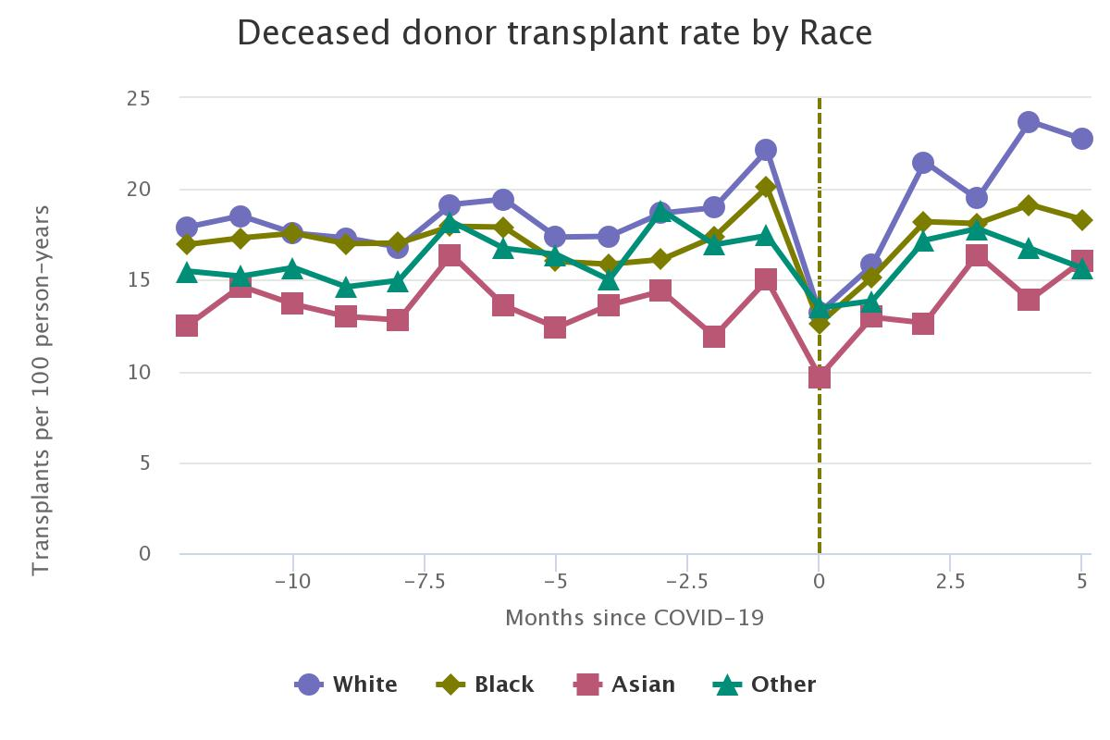
Deceased donor kidney transplant rate by race

Slide 20
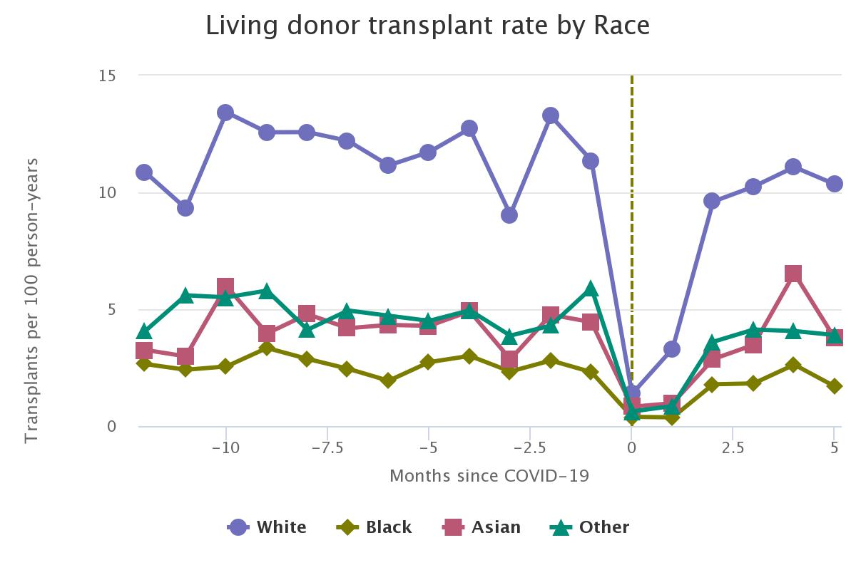
Living donor kidney transplant rate by race

Slide 21
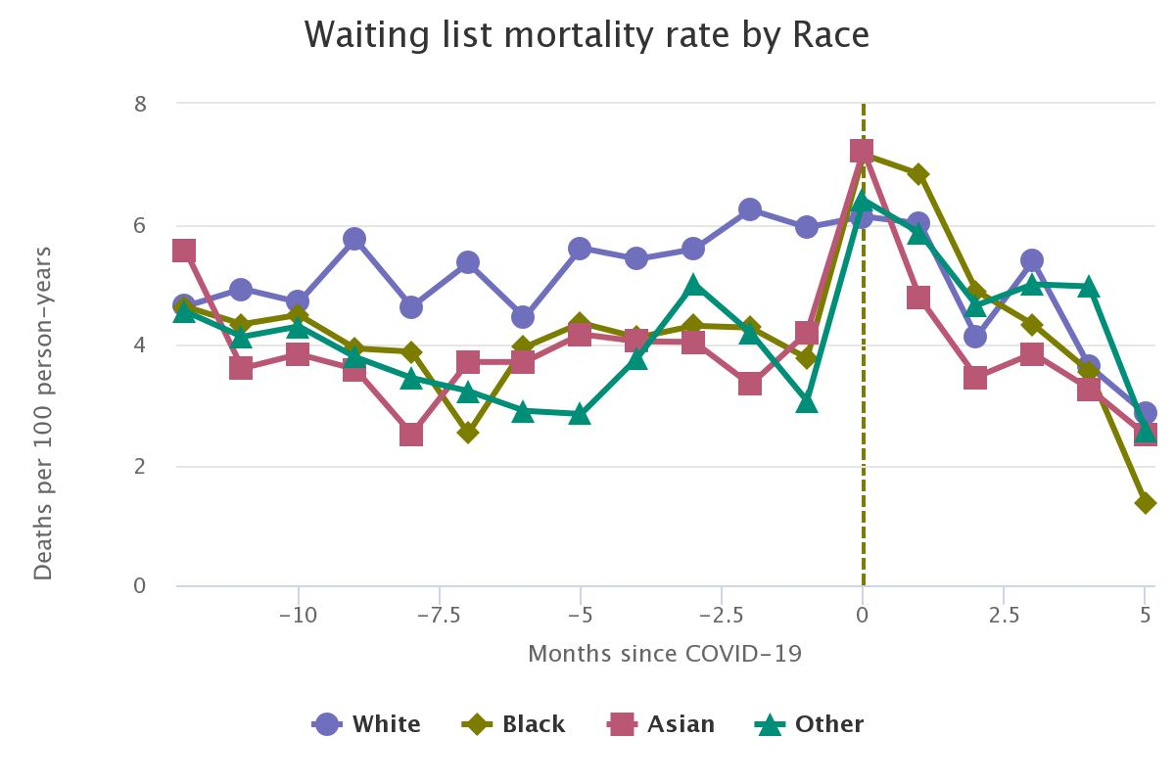
Kidney waiting list mortality rate by race

Slide 23
Acute impact of COVID-19
50% decline in deceased donor transplants
90% decline in living donor transplants
No disease transmission from donor to recipients
Limits to patient access to testing, testing availability, access to ICU beds
Repurposing staff, access to donor hospital ORs by outside teams, recipient safety, staff safety, transportation issues
System resilience

Slide 24
Where are we now?
Transplant numbers have essentially recovered
Donor numbers have recovered
Missed transplant opportunities early in pandemic
New waitlist additions remain about 10% lower than predicted
Impact of subsequent waves of infection likely to be less severe?

Slide 25
OPTN emergency policy actions
Emergency Action | Approval date | Current expiration date
Updates to Candidate Data During 2020 COVID-19 Emergency | March 17, 2020 | March 17, 2021
Relax Data Submission Requirements for Follow-Up Forms | April 3, 2020 | December 31, 2020
Modify Wait Time Initiation for Non-Dialysis Kidney Candidates | April 3, 2020 | December 31, 2020
Incorporate COVID-19 Infectious Disease Testing into DonorNet® | April 3, 2020 | December 31, 2020
Notes:
-These proposals were continuously evaluated, along with monitoring data on their use, at the Executive Committee meetings on April 3, April 20, June 7, and July 30
-The three latter actions originally had an expiration date of September 30, 2020, but the executive committee voted to extend it to December 31, 2020 at their meeting on July 30
-This extension puts all emergency action expiration dates after the December Board of Directors meeting, so that they all have time for full Board evaluation

Slide 26
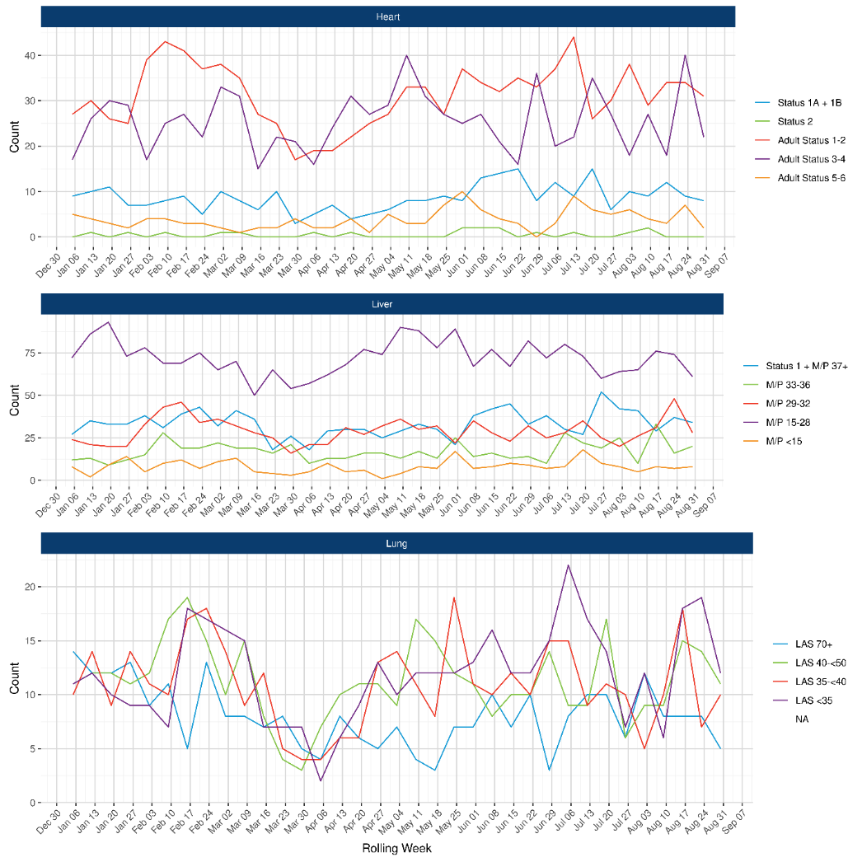
Medical urgency at time of transplant

Slide 27
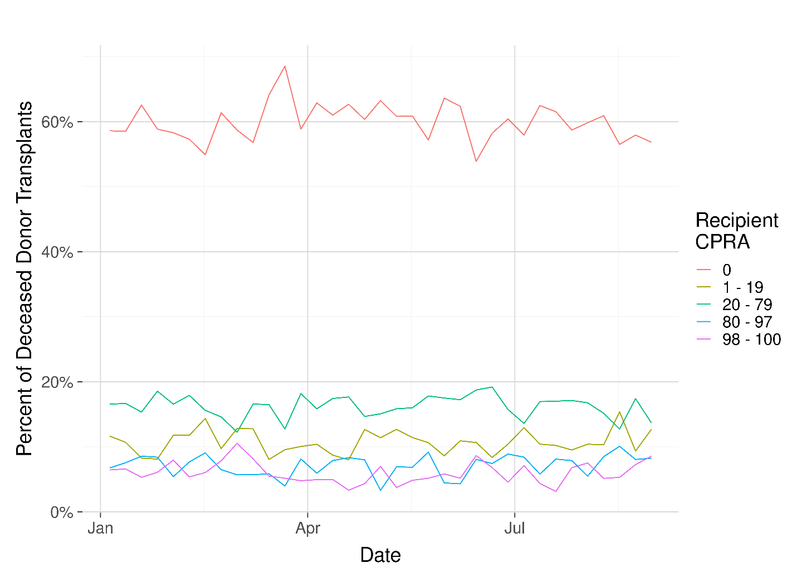
Kidney transplant CPRA

Slide 28
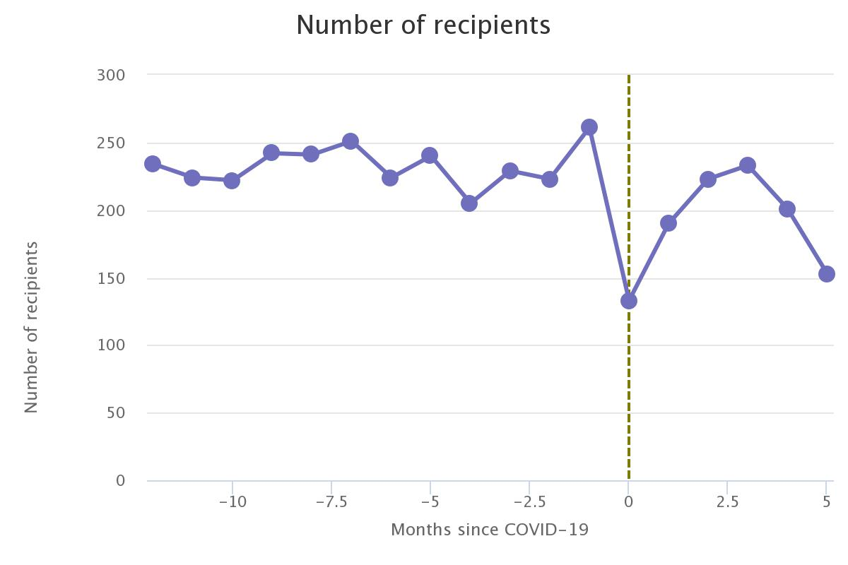
Lung transplants

Slide 29
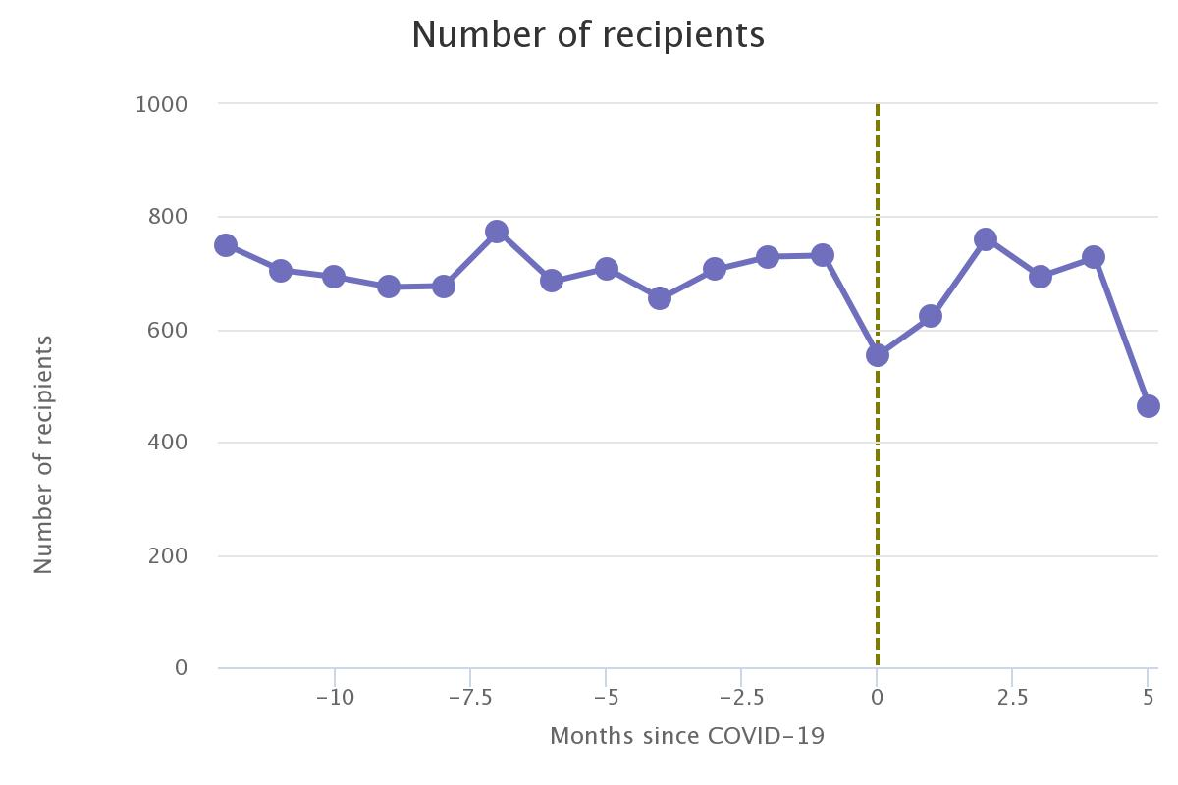
Liver transplants

Slide 30
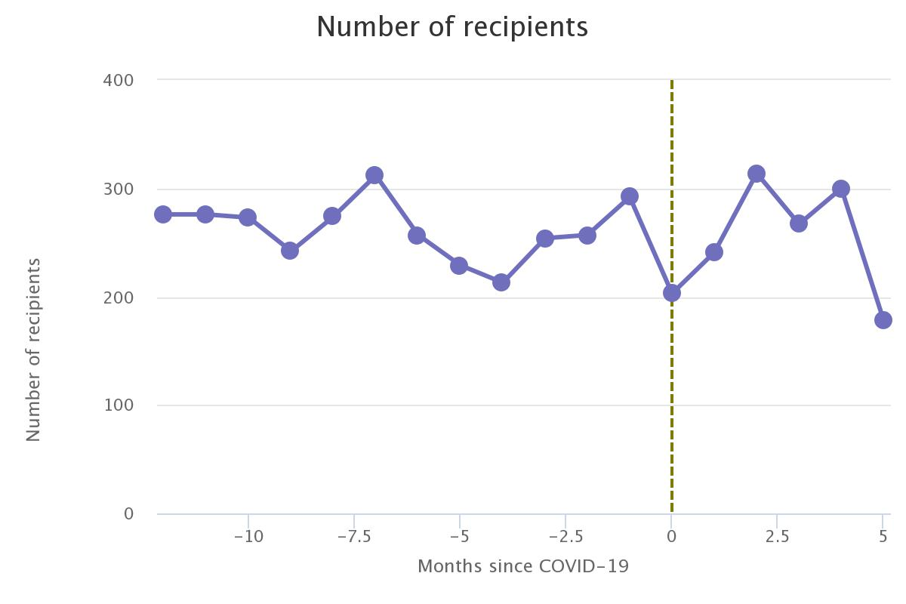
Heart transplants

Slide 31
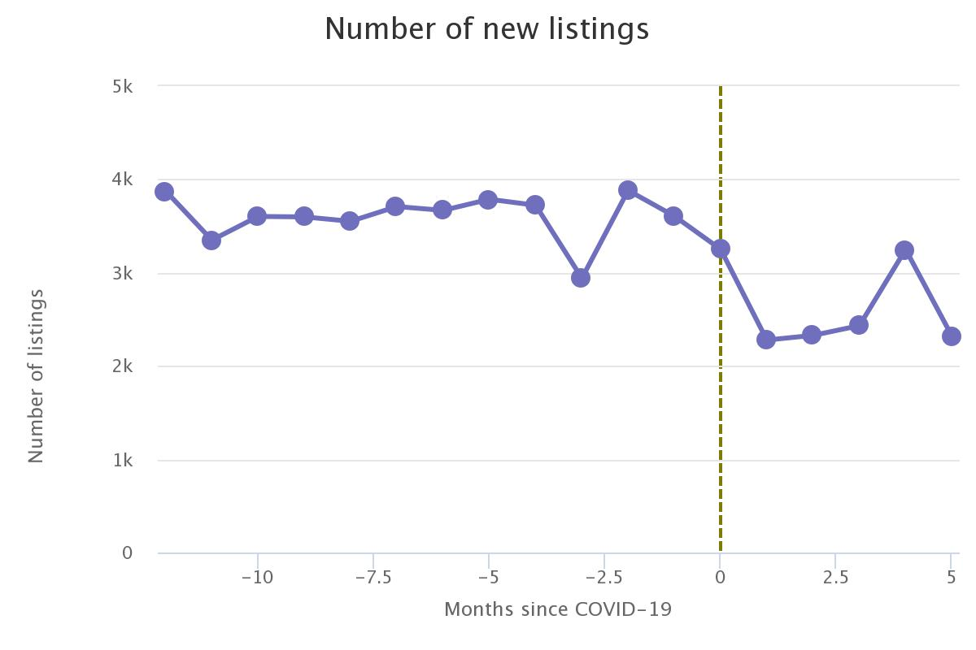
New kidney listings

